Slide 1
Toilet roll holder
TASK
Make each of the 3 parts of the toilet roll holder.
Open an assembly file and slot together
Open a drawing file (A3) and produce an Elevation, Plan, End view, and 3-D view of the object. Add names and dimensions to the drawing
EXTRA
Modify the existing design to make it function better. Sketch your idea on your sketch pad. Save your original part files a 2nd time and apply your changes

Slide 2
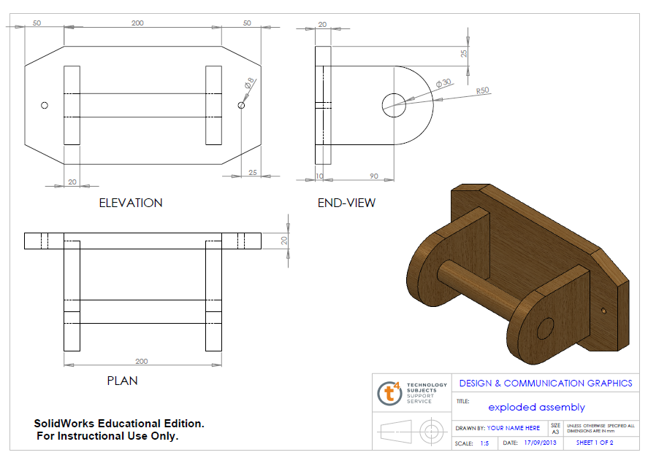

Slide 3
Assembly of Toilet roll holder

